Slide 1
DAMCO FRESH PRODUCE DIRECT
Soluciones integradas de Logistica Refrigerada de Puerta a Puerta a nivel global.

Slide 2
Porque trabajar con DAMCO? Esta usted interesado en reducir los costos en la cadena de suministro, mejorar la calidad, el tiempo de vida de sus productos frescos en el destino final y asegurar una entrega confiable?

Slide 3
DAMCO ofrece una vertical integrada de servicios logísticos (Puerta – Puerta) desde el origen del producto (productores, empacadores, embarcadores) hasta el punto de venta con su red de oficinas alrededor del mundo Estos servicios son - En Origen: BKA, LSS, FF, CHB, OCE & Seguros de carga. - En Destino: CHB, LSS, Cross Dock, Delivery & QC.
Porque trabajar con DAMCO?

Slide 4
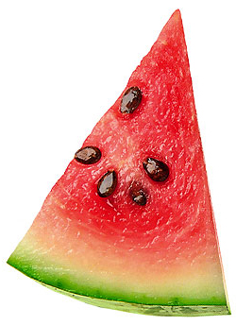
La Manera mas rápida de incrementar su rentabilidad es comprando directamente de la fuente.
Usted ve la oportunidad de negocio pero trabajar directamente con productores / exportadores puede ser un reto
El mejor acercamiento con el productor / exportador es ir reduciendo gradualmente el canal de intermediación
Con su propio desarrollo de la cadena de suministros, usted puede incrementar su rentabilidad, reduciendo la dependencia de intermediarios y optimizando la Logistica de transporte
15-20% Extra Profit

Slide 5
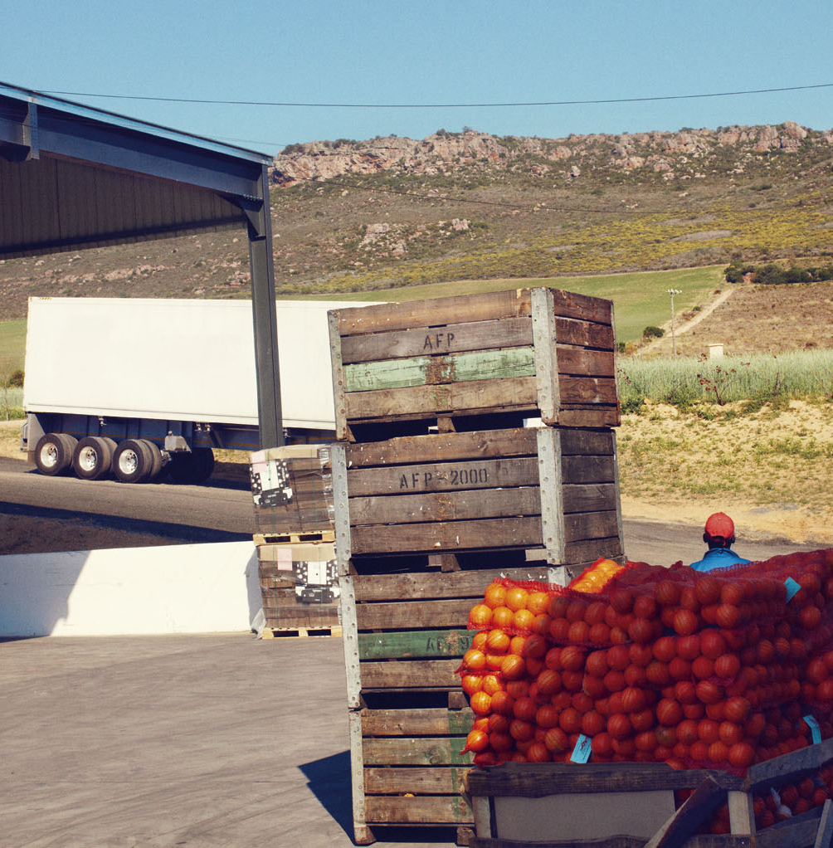
La Logistica de puerta a puerta para entregas directas a detallistas y mayoristas alrededor del mundo.
Damco Fresh Produce Direct:
Se ajusta perfectamente a los requerimientos y necesidades entre los compradores y las fuentes de suministros.
Inicia el control de la cadena de frio desde la finca.
Provee seguros de riesgos con coberturas eficientes.
Administra las locaciones en el transporte tanto marítimo y terrestre así como aéreo
Asegura un servicio especializado y transparencia en los costos
Visibilidad completa en toda la cadena Logistica.
ç
Notes:
Damco Fresh Produce Direct is an end-to-end logistics solution designed to help grower exporters of fresh produce deliver directly to wholesalers and retailers around the world.

Slide 6


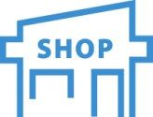









Damco Fresh Produce Direct ayuda a optimizar la cadena Logistica mientras reduce el canal mayorista.
Wholesale (Optimize FOB or CIF Logistics)
Grower’s control
Wholesaler’s control
Retailer’s control
FARM
SHOP
Retail (Optimize Logistics Direct from Farm)
Grower’s control
Retailer’s control
FARM
SHOP
Ensuring retailers can get highly perishable, high value, seasonal fresh produce all year round, reducing supply variation due to impact from weather and other natural disturbances.
Notes:
EXISTING
Multiple middlemen’ margins result in inflated final price or deflated grower price
No visibility of cost drivers: agents, transportation, manipulation
No ability to forecast price fluctuations
DIRECT
Average cost savings of 6-18% to DDP price
Visibility of cost drivers and ability to impact them
Relationship with the wholesaler/retailer resulting in easier forecast
Increase control of YOUR supply chain
Inventory flexibility through transparency

Slide 7
Alternativamente Damco Fresh Produce Direct puede optimizar al exportador la entregas a los CD de sus clientes
Wholesale (Optimize FOB or CIF Logistics)
Grower’s control
Wholesaler’s control
Retailer’s control
FARM
SHOP
Retail (Optimize Logistics Direct to Retailer)
Grower’s control
Retailer’s control
FARM
SHOP
Ensuring grower exporters maximize their revenue and profit when delivering direct, while reducing cost and increase quality at shop floor level.
Notes:
EXISTING
Multiple middlemen’ margins result in inflated final price or deflated grower price
No visibility of cost drivers: agents, transportation, manipulation
No ability to forecast price fluctuations
DIRECT
Average cost savings of 6-18% to DDP price
Visibility of cost drivers and ability to impact them
Relationship with the wholesaler/retailer resulting in easier forecast
Increase control of YOUR supply chain
Inventory flexibility through transparency

Slide 8
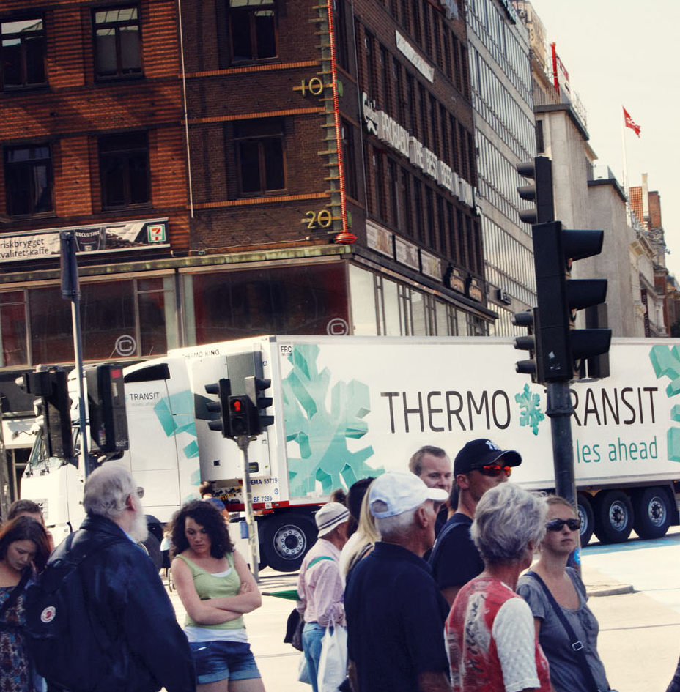
Deje de recibir en su puerta Comience a comprar en Origen
Ofreciendo muchos beneficios y minimizando riesgos:
Incrementando la Confianza (Controlando la cadena)
Incrementando el Servicio (Rápido y Flexible)
Reduciendo Costos (Ahorros de hasta un 20%)
Reduciendo Riesgos (Optimizando las condiciones)
Incrementando la Sostenibilidad (Menos emisiones de CO2)
Reduciendo la Complejidad (Un Solo Contacto)
ç
Notes:
By using Damco Fresh Produce Direct you will receive the following benefits and at the same time mitigate the risks that are normally connected with this type of logistics approach:
Increased Reliability (More Than 99%)
Our dedicated team, global systems, standard processes for handling exceptions at agreed key milestones, regular review of performance, and “prevent, manage, recover”
principles ensure your produce arrives on-time, every time.
Improved Service (Faster & Flexible)
Our independence from specific transportation providers ensures you can deliver according to your requirements rather than a fixed timetable. The value added services we
provide can be customized to meet your specific needs. This typically results in your produce getting to market faster and with the specifications required.
Reduced Costs (By Up To 20%)
Delivering directly can typically lower costs by up to 20%, which enables growers, grower exporters and retailers to invest savings in growth. We can also help manage logistics
costs during peak seasons by securing required air and ocean carrier allocations at fixed freight rates.
Reduced Risk (Optimal Condition)
Our people are responsible for managing all steps in the chain, minimizing the risk of anything going wrong. Cargo inspections increase insurability and reduce premiums.
End-to-end visibility on a multi-carrier level provides traceability and ensures that you can stay in control of your shipments and reduce risk to a minimum. If something does
go wrong, our claim handling expertise will help ensure your claim gets resolved in a timely manner.
Increased Sustainability (Less Waste And Co2)
By optimizing the movement of your produce across all available routes and transport modes, we can not only reduce cost but also reduce the carbon emissions required
to get it to market. By ensuring full control within each step in the chain we can also reduce waste, ensuring far more of your produce gets to market in optimal condition.
Reduced Complexity (One Contact)
With one point of contact across the supply chain, one contract and one bill, you can significantly reduce your administrative burden and the resources you typically use
managing shipments. With access to our expert Supply Chain Development team you can explore new opportunities quicker and with more certainty than ever before.

Slide 9
Se obtienen ganancias adicionales al incrementar la visibilidad y control a lo largo de la cadena
Large ”margins eaters” like net exporter & net importer
Indicative of areas where cost cost savings are typically realized
Improved quality
equal to 5-8%
Grower Exporter Cost
Local Transport (including damage)
Certification & Documentation
FOB Margin (Net Exporter)
Ocean and air Freight
Insurance & Monitoring
Certification & Documentation
CIF Margin (Importer)
Packing & Labeling
Local Transport
Retailer Cost
Notes:
Remove non-value adding steps in the supply chain
Manage costs and pay only for what is needed
Benefit from economies of scale and flexibility

Slide 10

Damco provee todos los componentes necesarios para asegurar la Logistica mas eficiente puerta a puerta
Desarrollo de la cadena de suministro
Administración de la cadena de suministro
Visibilidad
➔
Origin
Services
Transport
Services
Destination
Services
➔
➔
➔
ç
Notes:
We can offer anything from simple freight forwarding to highly sophisticated and integrated end-to-end logistics solutions. We know that no two customers are the same, and therefore we design individual solutions to meet individual needs, putting together only those components that are truly needed. As an independent third party logistics provider we are not bound to one partner, but instead work with many different partners to ensure objectivity and the best available price.
SUPPLY CHAIN DEVELOPMENT
Supply chain design, integration, development and optimization services
SUPPLY CHAIN MANAGEMENT
End-to-end management of supply chains and at all levels – operational, tactical and strategic
VISIBILITY
Our visibility systems provide pick-up, shipping, airfreight and delivery reporting on pallet & container level. We make sure you have the right trade documentation,
authenticated by the right people at the right time.

Slide 11

Embarcando a tiempo
Origin
Services
➔
Cadena de Frio desde la Finca
Consolidación de la carga en estaciones de empaque
Transporte de la empacadora al puerto o centro de consolidación.
Tramites de exportación y documentación
Seguros de carga e inspecciones de calidad
Notes:
ORIGIN SERVICES
Our teams at origin provide all the services required to make sure your produce is shipped on-time, in the form required and in accordance with all local procedures, rules and regulations.

Slide 12
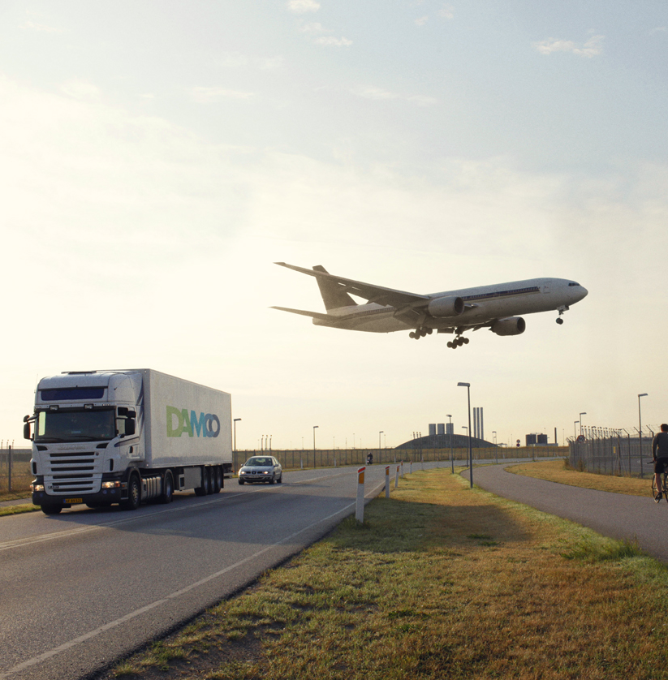
Administrando los diferentes modos de transporte
Transport
Services
➔
Manejos de carga multimodales (Terrestre – Marítimo – Aéreo)
Garantizando espacios durante las temporadas altas
Monitoreo y control de temperatura y unidad de transporte durante todo el viaje
Pro-activos ante las eventualidades
Administración de información y documentación
ç
ç
Notes:
TRANSPORT SERVICES
Our transport teams manage the planning and booking of all modes of transportation. Our global network allows us to cover 10,000 air and sea corridors worldwide. We provide full service solutions to meet all needs.

Slide 13


Habilidad para balancear costos, Huella de CO2 y tiempo de entrega
Transport
Services
➔
Cost & CO₂
Example:
Peak direct Air Rates to Northern Europe are in the $2.75/kg. all-in range, with a transit time of 2 days.
Example:
Sea-Air can take 7-10 days and costs around $2.25/kg.
Example:
Traditional ocean transit costs approximately $1.40-$1.60/kg.
Air Sea-air Ocean
1 5 10 15 25 30
Transit time (days)
Notes:
When it comes to transportation, finding the optimal mix of air, sea-air and ocean is a major factor in reducing overall cost and carbon emissions. However, understanding the trade-offs and managing the risks posed by varying transit times can be challenging.
Damco has a simplified way of helping you select the optimal transport mix based on days, cost and carbon rather than merely mode. We make the differences between transport types transparent, enabling you to make the right decisions for your cargo, optimizing the mix to meet your business needs.
Our customers tell us this facilitates an informed discussion within their business, ensuring that buying, merchandising and logistics talk the same language, and are empowered to make the right supply chain decisions together.
Once those decisions are made, up-to-date information and active exception handling reduce the risk of transport time changes, while our “one contact” approach reduces the complexity of managing a mix of air, sea-air and ocean.
13

Slide 14
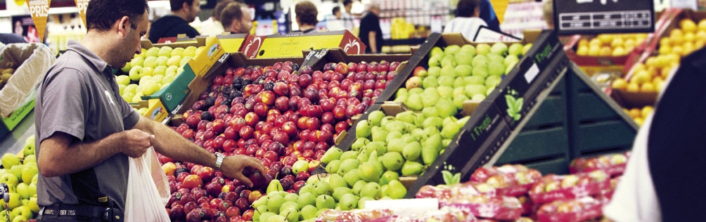
Entregando en el lugar correcto y a tiempo.
Destination
Services
➔
Manejo control de demoras
Trámites y documentación de importación
Inspecciones de calidad
Almacenamiento y distribución
Clasificación y etiquetado.
Transporte hacia los centros de distribución y puntos de ventas.
Administración de facturación
Notes:
DESTINATION SERVICES
Our destination teams provide the services to ensure your produce is collected and delivered to the right place, on time and in full.

Slide 15
Red Reefer Global
EUR
Erik Osinga
NAM
Mauro Suazo
NAS
LAM / CAM
Anne Marcotty
Oscar Oporta
MEA
Wade Thompson
LAM / WCSA
SAA
Joe Salinas
Purnendu Shekhar
LAM / ECSA
AFR
APA
Axel Kreutzmann
Chris Baard
Henning Malmgren

Slide 16
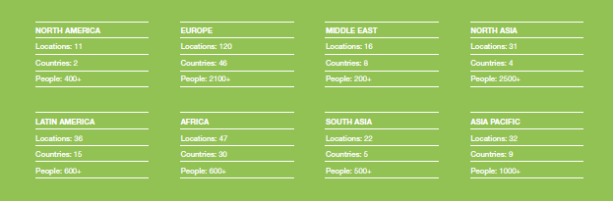
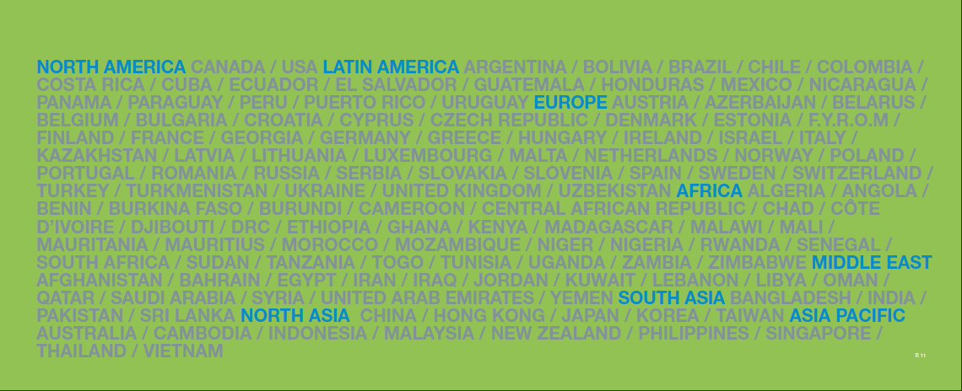
Estamos localizados tan cerca de su cliente potencial así como de usted
Notes:
We are experts in managing fresh produce logistics. We have on the ground presence and fresh produce expertise in all major export and import markets. A brief overview of our global capabilities (as of June 2010) is shown here.

Slide 17

























Nuestros Principales Clientes en las diferentes industrias.
Reefer & Perishables
Retail
High Value Consumer Goods
Government & Defense
Chemicals
Aid & Relief
Notes:
Please ensure not to show these logos to bigger groups, or in situations where competitors will be doing the same.
17

Slide 18


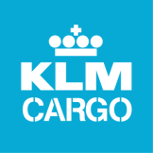
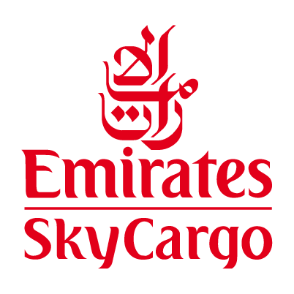
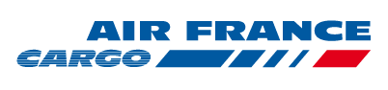

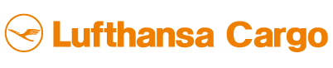

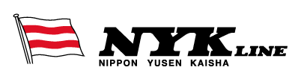


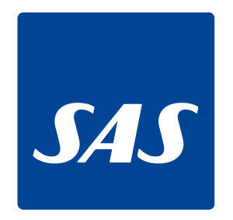
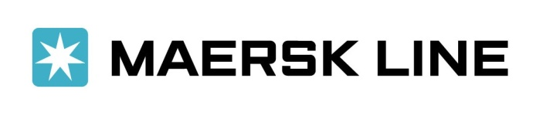


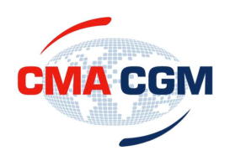









Nuestra red de alianzas en transporte
Notes:
Networks [the reach]
Carriers for both Ocean and Airfreight which Damco have partnership agreements with.
18

Slide 19
Gracias!!
Mauro Suazo; Reefer Business Director North America
Oscar Oporta; Reefer Business Director Central America

